Slide 1
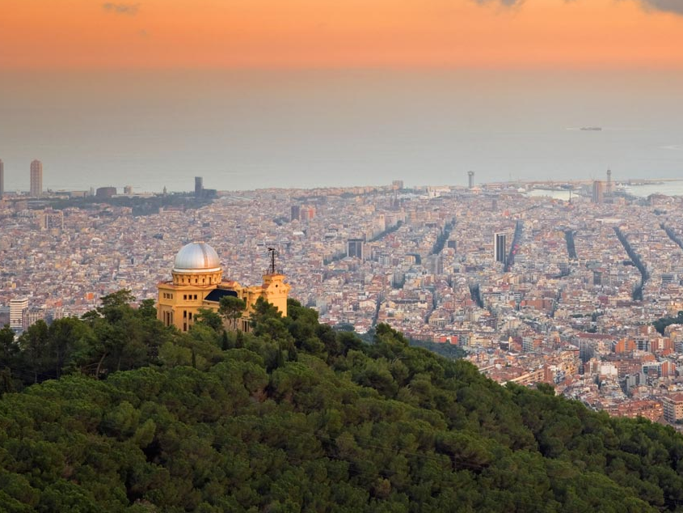


SharePoint Framework (spfx) Reciclaje de desarrolladores de SP "clásicos"
Luis Mañez - ClearPeople
@luismanez
Notes:
Template may be modified but please keep the title and the sponsor slide.
Twitter hashtag: #spsbcn for all sessions

Slide 2







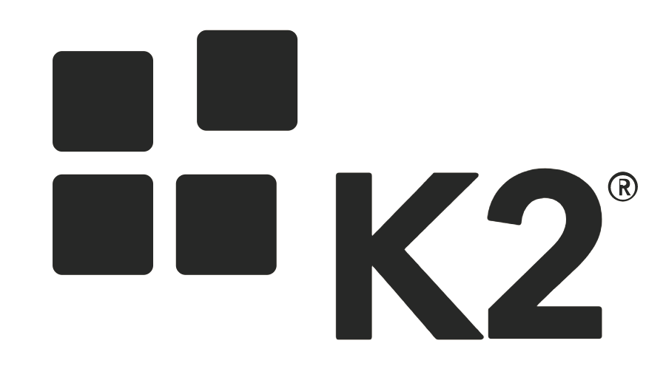








Thanks to our Sponsors
Gold
Silver
Raffle
Organized by
Notes:
Use this as the first slide in your slide deck

Slide 3
SharePoint
is not SharePoint
anymore

Slide 4
BE
MODERN

Slide 5
Modern WebParts Samples

Slide 6



Technology mapping Classic vs Modern
FX

Slide 7
Learning Roadmap
FX

Slide 8


Close the f***
Power Point
And
Show me
Code !!

Slide 9
Real World problems: Modern solutions to Classic problems
Problem | Modern SharePoint
Webpart | Spfx webpart
Custom Actions | Spfx Extensions (App Customiser, ListViewCommandSet)
Custom Field Types | Spfx Extensions (Field customisers)
Get SharePoint data | spHttpClient (Webpart context)
Get MS Graph data | graphHttpClient (Webpart context)
Calling custom API | Azure AD + ADAL.js (with limitations)
Application Lifecycle Management | VSTS Build + PnP utilities
Provisioning | PnP Schema + PnP Provisioning
Timer Jobs | Azure Functions + Azure AD + MSAL (ADAL)
Event Handlers | Webhooks
Run With Elevated Privileges | Not in Webparts / Custom API with Application Permissions
Custom Forms | Power Apps / MS Forms
Workflows | Webhooks / MS Flow

Slide 10
Thank you!
Questions?
#SPSBCN

